Slide 1
Medium Access Control Protocols
or
Channel Access Methods(CAMs)

Slide 2
Local Area Network

Slide 3
Local Area Network

Slide 4
Wireless Local Area Network

Slide 5
Wireless Wide Area Network
using satellite communications

Slide 6

Mobile phone network

Slide 7
In all these applications :
Multiple user nodes ( stations ) share
a common media / channel
for information exchange

Slide 8
Multiple Access Communications
Shared media basis for broadcast networks
Inexpensive: radio over air; copper or coaxial cable
M users communicate by broadcasting into medium
Key issue: How to share the medium?
3
2
4
1
Shared multiple
access medium
M
5
…

Slide 9
Multiple Access Control /
Media Access Control
( MAC )
Protocols

Slide 10
Applications
W
EtheLAN
Blue-tooth
FIbre Distributed Data Interface ( FDDI )Rings
ATM ( Automatic Teller Machines) networks

Slide 11
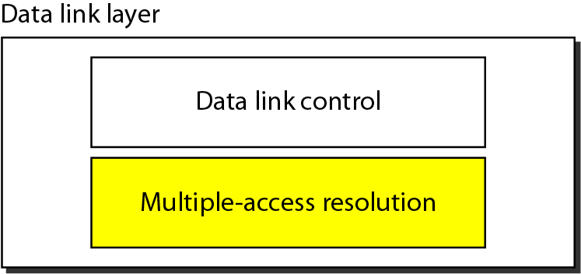
Data link layer divided into ………

Slide 12
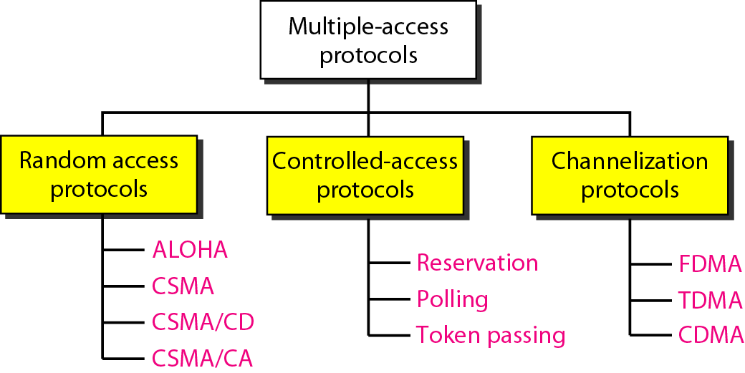
Multiple-access protocols

Slide 13
Multiple-access protocols

Slide 14
RANDOM ACCESS
In random access or contention methods,
No station is superior to another station and none is
assigned the control over another.
No station permits, or does not permit, another
station to send.
At each instance, a station that has data to send uses a procedure defined by the protocol to make a decision on whether or not to send.

Slide 15
RANDOM ACCESS
In a random access method, each station has the right to the medium without being controlled by any other station.
If more than one station tries to send, there is an access conflict- collision -and the frames will be either destroyed or modified.

Slide 16
RANDOM ACCESS
To avoid access conflict or to resolve it when it happens, each station follows a procedure that answers the following questions:
When can the station access the medium?
What can the station do if the medium is busy?
How can the station determine the success or failure of
the transmission?
What can the station do if there is an access conflict?

Slide 17
Random Access protocols
Let us study one MAC protocol
as
an example

Slide 18
Random Access protocol #3
Carrier Sense Multiple Access with Collision Detection
(CSMA/CD)

Slide 19
CSMA
To minimize the chance of collision and, therefore, increase the performance, the CSMA method was developed.
The chance of collision can be reduced if a station senses the medium before trying to use it.

Slide 20
CSMA
CSMA requires that each station first listen to the medium (or check the state of the medium) before sending.
In other words, CSMA is based on the principle "sense before transmit" or "listen before talk.”

Slide 21
CSMA
CSMA can reduce the possibility of collision, but it cannot eliminate it.
The reason for this is (shown in Figure 12.8.) stations are connected to a shared channel (usually a dedicated medium).

Slide 22
CSMA
The possibility of collision still exists in CSMA because of propagation delay;
when a station sends a frame, it still takes time for the first bit to reach every station and for every station to sense it.
In other words, a station may sense the medium and find
it idle, only because the first bit sent by another station has not yet been received.

Slide 23
CSMA
In Figure 12.8.
At time t₁ , station A senses the medium and finds it idle, so it sends a frame.
At time t₂ (t₂ > t_{I}) station Z senses the medium and finds it idle because, at this time, the first bits from station A have not reached station Z.
Station Z also sends a frame. The two signals collide and both frames are destroyed.

Slide 24
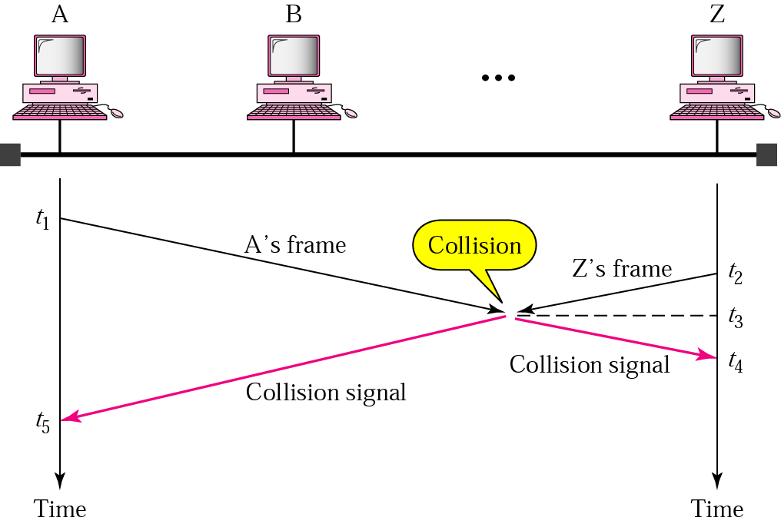
Figure 12.8 Collision in CSMA

Slide 25
Persistence Methods
1. What should a station do if the channel is busy?
2. What should a station do if the channel is idle?
Three methods have been devised to answer these questions:
One-persistent method,
Nonpersistent method, and
p-persistent method.
Figure 12.10 shows the behavior of three persistence methods when a station finds a channel busy.

Slide 26
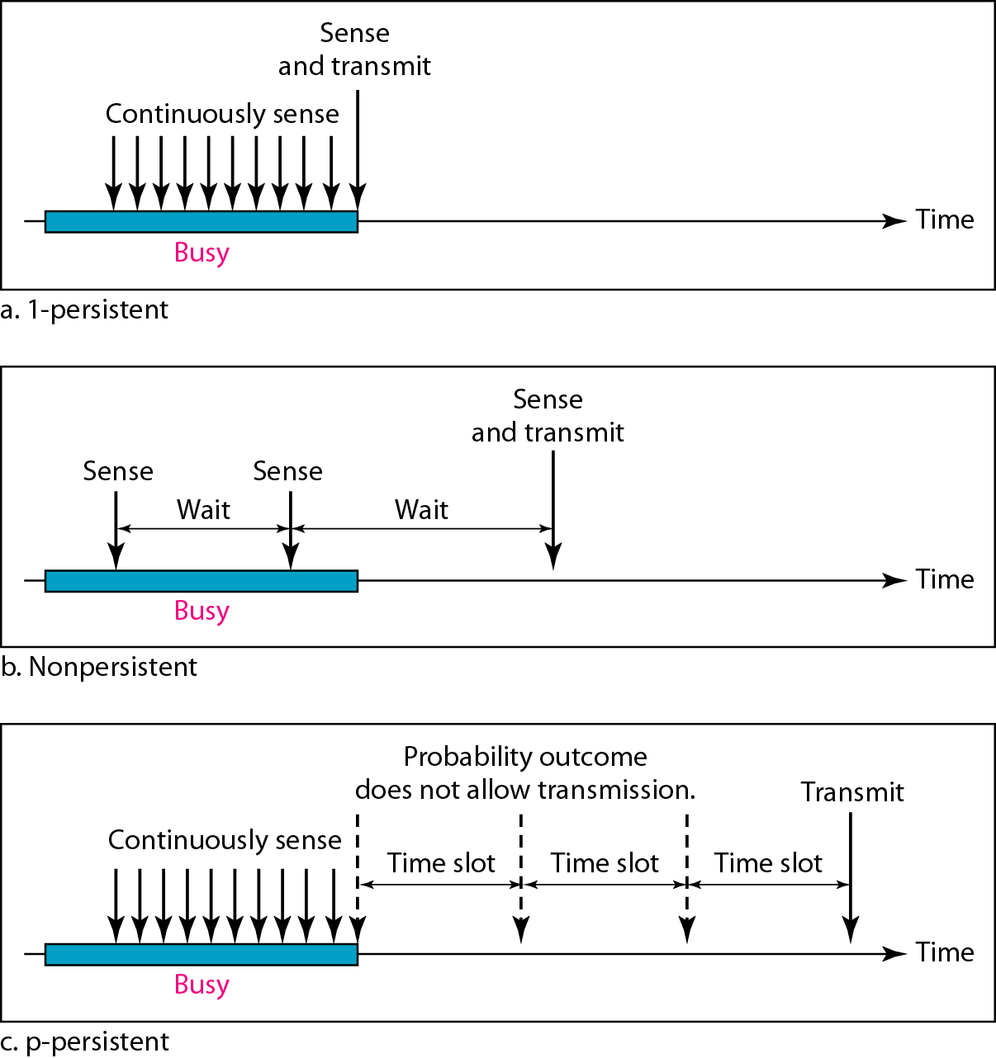
Figure 12.10 Behavior of three persistence methods

Slide 27
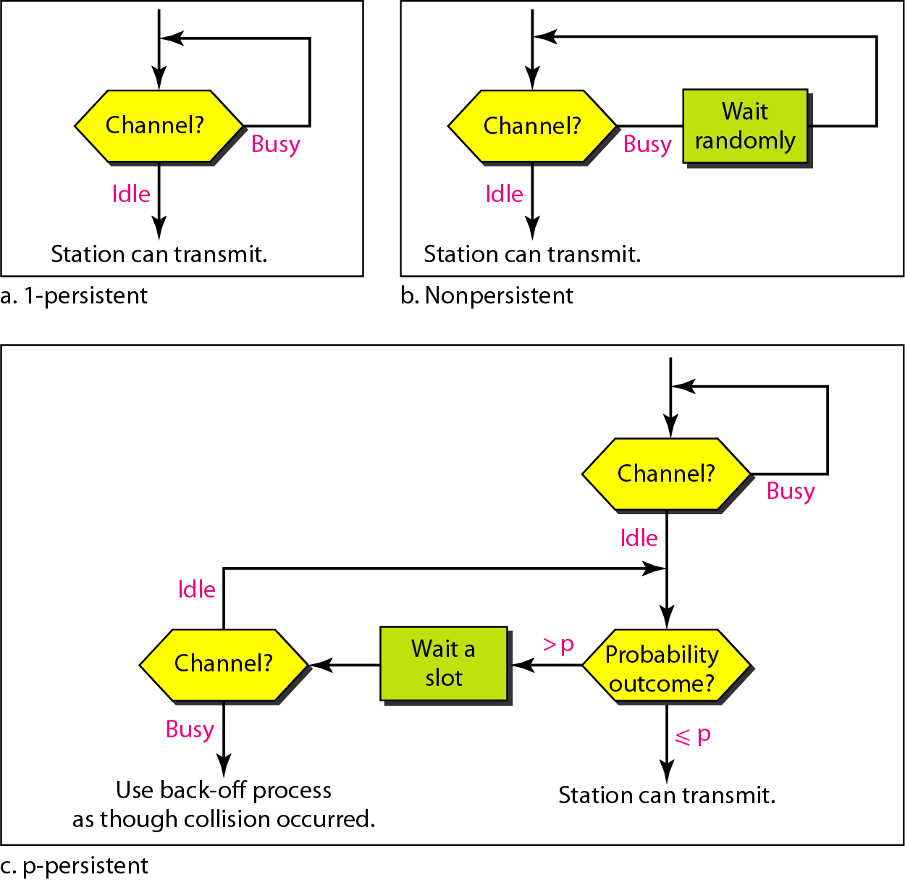
Figure 12.11 Flow diagram for three persistence methods

Slide 28
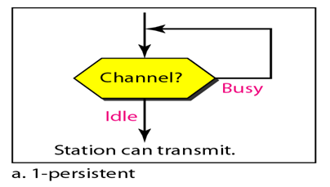
Persistence Methods
1-Persistent :
The 1-persistent method is simple and straightforward. In this method, after the station finds the line idle, it sends its frame immediately (with probability 1).
This method has the highest chance of collision because two or more stations may find the line idle and send their frames immediately. Ethernet uses this method.

Slide 29
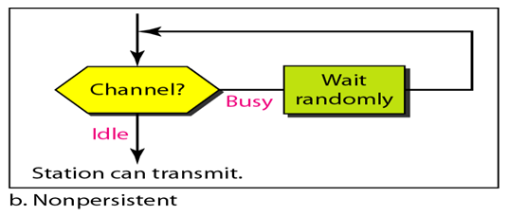
Persistence Methods
Nonpersistent:
In the nonpersistent method, a station that has a frame to send
senses the line. If the line is idle, it sends immediately. If the line is not idle, it waits a random amount of time and then senses the line again.

Slide 30
Persistence Methods
Nonpersistent:
The nonpersistent approach reduces the chance of collision because it is unlikely that two or more stations will wait the same amount of time and retry to send simultaneously.
This method reduces the efficiency of the network because the medium remains idle when there may be stations with frames to send.

Slide 31
Persistence Methods
p-Persistent :
The p-persistent method is used if the channel has time slots with a slot duration equal to or greater than the maximum propagation time.
The p-persistent approach combines the advantages of the other two strategies.
It reduces the chance of collision and improves efficiency.

Slide 32
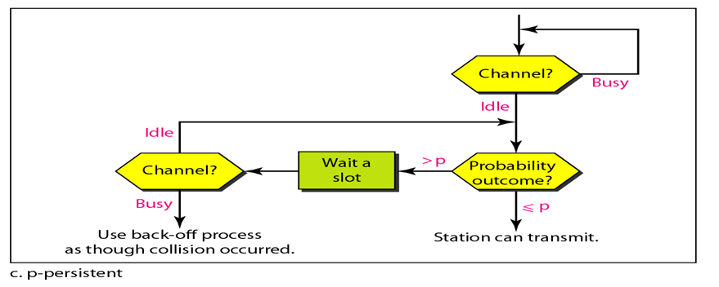
Persistence Methods
p-Persistent :
In this method, after the station finds the line idle it follows these steps:
1. With probability p, the station sends its frame.
2. With probability q = 1 - p, the station waits for the beginning of the next time
slot and checks the line again.
If the line is idle, it goes to step 1.
If the line is busy, it acts as though a collision has occurred and uses the backoff procedure.

Slide 33
CSMA/CD
The CSMA method does not specify the procedure following a collision.
Carrier sense multiple access with collision detection (CSMA/CD) augments the algorithm to handle the collision.

Slide 34
CSMA/CD
Step 1: A station with a frame to transmit waits until the channel is silent.
Step 2: When channel becomes silent, station transmits but continues to listen for collisions.
Step 3: If a collision occurs, the station aborts the transmission, waits for a random time to reattempt the transmission time.
If the collision doesn't occur within 2 propagation delay times [mini-slot time], then station knows that it has captured the channel

Slide 35
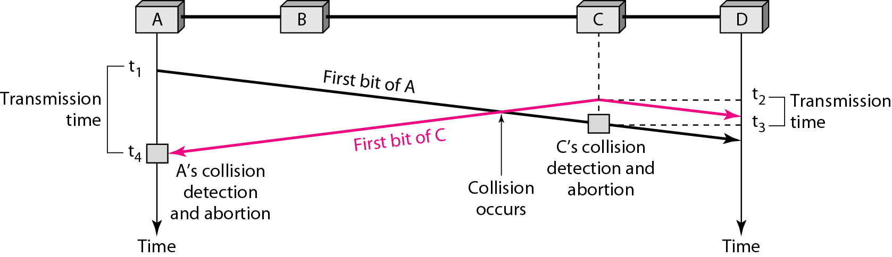
Figure 12.12 Collision of the first bit in CSMA/CD

Slide 36
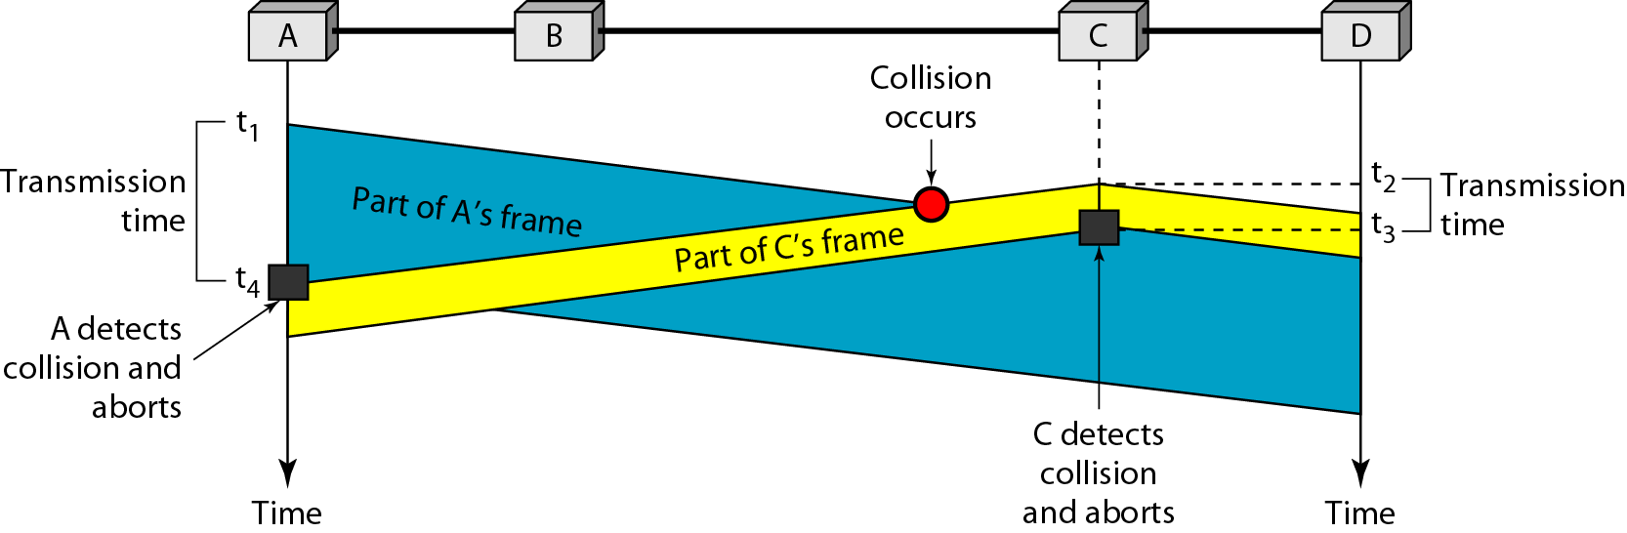
Figure 12.13 Collision and abortion in CSMA/CD

Slide 37
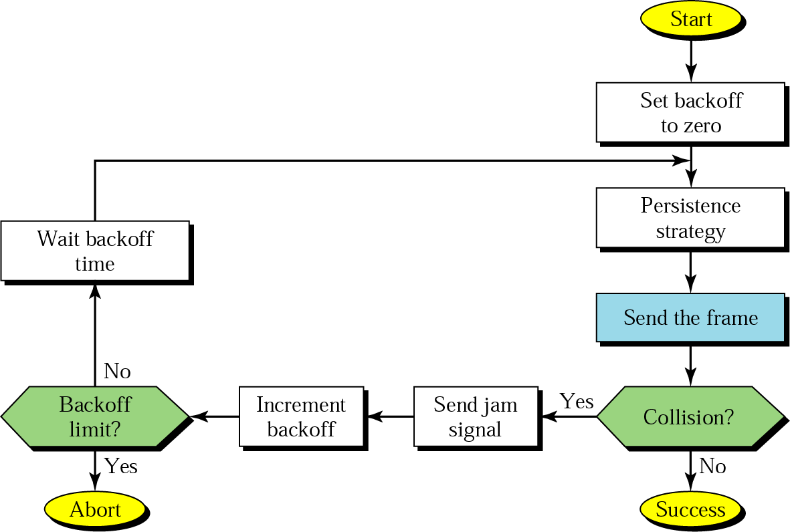
Figure 13.7 CSMA/CD procedure

Slide 38
What is the significance of jam signal in CSMA/CD ?
If the station hears a collision, it sends jam signal to the line to inform other stations of the situation and to alert them that a collision has occurred

Slide 39
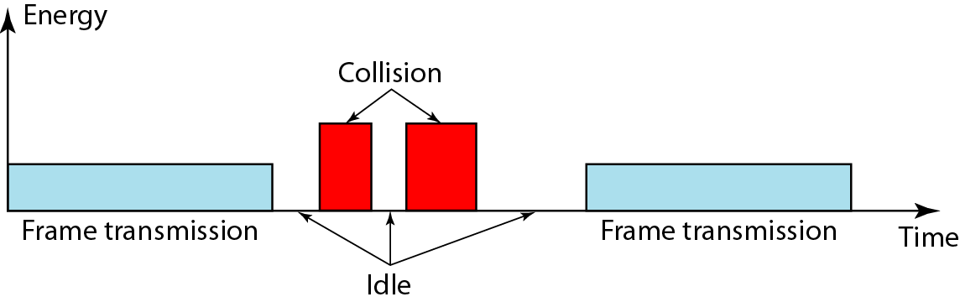
How is collision detected in CSMA/CD?
Station uses a separate port ( other than data port ) to detect collision.
In normal condition, collision detection port receives the normal signal or no signal.
When collision occurs, it receives higher energy signal.
Figure 12.15 Energy level during transmission, idleness, or collision

Slide 40
CSMA/CD is not suitable for wireless LAN
Why ?

Slide 41
In case of wireless medium, it is difficult to sense the collision, because collided signal strength may decrease due to propagation
Hence CSMA/CD is not suitable for wireless LANs
What is the solution??
CSMA / CA Protocol

